Slide 1
Sequencing strategies in resource-limited countries
Leticia M. Pérez Saleme M.D.
Servicio de Infectología
Hospital de Especialidades, CMN SXXI
Instituto Mexicano del Seguro Social
México City

Slide 2
Disclosures
Grants/research support: ViiV Healthcare
Advisory boards: Gilead Sciences, GSK, Sandoz
Consultant: none
Speakers bureau: Gilead, BMS, Janssen, Sandoz
Educational support: Gilead, Janssen
Other financial or material support: None

Slide 3
ART in RLS
Access to ART in resource-limited setting (RLS) has increased in the past decade, and has been associated with a decrease in HIV morbidity and mortality
The majority of patients in RLS are still initiating EFV based regimens
There is limited access to VL monitoring, which delays the diagnosis of viral failure (VF) and the subsequent change to second-line regimens (2LR)
An estimated 3-20% of patients in RLS receive second-line ART
Different factors associated with the efficacy of a 2LR have been identified such as adherence and resistance
Current WHO guidelines recommend a second-line regimen based on bPI+ 2 NRTIs after failure of NNRTI based first-line (1LR)

Slide 4
Study | Treatment Setting | N | Regimen LPV/r + 2-3 NRTI vs | Results
EARNEST^{[1]} Africa | Clinical Failure No R test results available to clinicians | 1277 | LPV/r + RAL 12w – LPV/r | Non-inferiority LPV/r + 2/3 NRTIs; improved efficacy vs LPV/r monotherapy
SECOND-LINE^{[2]} M & HIC Australia, Africa, Asia, Europe, LA | Failure VL>500 Geno available select NRTI 97% BL R to al least 1 drug | 541 | LPV/r + RAL | Non-inferiority LPV/r + 2/3 NRTIs
SELECT A5273^{[3]} Africa, Asia, LA | Failure VL>1000 No R test results available to clinicians BL 95% R 2 drugs | 512 | LPV/r + RAL | Non-inferiority LPV/r+ 2-3 NRTI TDF or AZT
2LADY⁽⁴⁾ Africa | Failure VL>1000 No R test results available to clinicians BL 95% R 2 drugs Adherence support | 454 | DRV/r + TDF/FTC | Similar efficacy as LPV/r + TDF/FTC or ABC/ddI
DAWNING⁽⁵⁾ Africa, Asia, LA | Failure VL>400 Geno results available ,No PR to PI or II, at least 1 active NRTI | 627 | DTG + 2 NRTI* | Better than LPV/r + 2 NRTI Interim analysis DMC discontinuation LPV/r arm
1,Paton NI, et al. N Engl J Med. 2014;371:234-247. 2. Amin J, et al. PLoS One. 2015;10:e0118228. 3. La Rosa AM, et al. CROI 2016. Abstract 30., Lancet hIV 2016;3(6):e247-e258 4. Ciaffi L et al AIDS 2015;29:1473-81;
5. Aboud M et al CROI 2018, Abstract 508
Notes:
LPV, lopinavir; NRTI, nucleoside reverse-transcriptase inhibitor; RAL, raltegravir; RTV, ritonavir.
PR primary resistance DMC data and monitoring committtee
EARNEST^{[1]} Africa (Uganda, Zimbabwe, Malawi, Kenya)(Argentina, Australia, Chile, UK, France, Hong Kong, India, Israel, Malaysia, Mexico, Peru, Nigeria, Singapore, South Africa, Thailand)
SECOND-LINE^{[2]} M & HIC Australia, Africa, Asia, Europe, LA (Argentina, Australia, Chile, UK, France, Hong Kong, India, Israel, Malaysia, Mexico, Peru, Nigeria, Singapore, South Africa, Thailand)
SECOND-LINE^{[2]} M & HIC Australia, Africa, Asia, Europe, LA (Argentina, Australia, Chile, UK, France, Hong Kong, India, Israel, Malaysia, Mexico, Peru, Nigeria, Singapore, South Africa, Thailand)
2LADY⁽⁴⁾ Africa (Cameroon, Senegal, Burkina Faso)
DAWNING⁽⁵⁾ Africa, Asia, LA (Argentina, Brazil, Chile, Colombia, Mexico, Peru, China, Thailand, Romania, Russia, Ukraine, Kenya, S Africa)
2 Lady: VF: VL >1000 c/mL, after 1 month of adherence support. Baseline genotypic drug resistance was performed retrospectively for all pts mITT (modified intention-to-treat) analysis, witch included pts who received at lesat one dose of the assigned tx and excluded pts with major protocol violation. Using a mITT analysis, which included patients who received at least one dose of the assigned treatment and excluded with major protocol violations. The following were considered failures: patients with viral load at least 50 copies/ml at week 48, non-completers at week 48 for whatever reason and those who switched ART before week 48 for whatever reason, except pregnancy and .We also performed per protocol comparison of the three groups which included patients still receiving the assigned treatment at week 48 and those who changed ART because of virological failure before week 48
At baseline 95% of participants had a virus resistant to at leat two first-line drugs group. For the TDF/FTC þ DRV/r combination, we observed a lower response (22.7%) at the 50 copies/ml threshold. Our patient population differed from those of other trials using DRV-based regimens [23]. We may hypothesize that once-daily dose of 800/100 mg might be insufficient for patients with partially active triple therapy

Slide 5
EARNEST: bPI + RAL Comparable to bPI + NRTIs and better than PI monotherapy
LPV/RTV + RAL (n = 433)
LPV/RTV + 2/3 NRTIs (n = 426)
LPV/RTV monotherapy (n = 418)
100
P < .001
88
85
80
77
81
73
74
60
61
Pts (%)
44
Pts (%)
40
20
0
HIV-1 RNA < 50 copies/mL, Wk 96^{[1]}
0
1
2-3
LPV/ RTV + RAL
LPV/ RTV
LPV/RTV + NRTI
(Number of Active NRTIs)
HIV-1 RNA < 400 copies/mL
Through Wk 144^{[2]}
1. Paton NI, et al. N Engl J Med. 2014;371:234-247. 2. Paton, NI, et al. ACHA 2015.
3. Amin J, et al. PLoS One. 2015;10:e0118228. 4. La Rosa AM, et al. CROI 2016. Abstract 30.
5. La Rosa AM, et al. Lancet HIV. 2016;3:e247-e258
Notes:
LPV, lopinavir; RAL, raltegravir; RTV, ritonavir; VF, virologic failure..
References:
1. Paton NI, et al. N Engl J Med. 2014;371:234-247. 2. Paton, NI, et al. ACHA 2015.
3. Amin J, et al. PLoS One. 2015;10:e0118228. 4. La Rosa AM, et al. CROI 2016. Abstract 30.
5. La Rosa AM, et al. Lancet HIV. 2016;3:e247-e258.

Slide 6
DAWNING: Impact of NRTI Backbone on Efficacy of DTG vs LPV/RTV as Second-line ART
HIV-1 RNA < 50 c/mL at Wk 24 by Second-line Background Regimen
WHO-Recommended Second-line NRTIs 56%
Yes
No
Yes
No
Yes
No
Treatment Difference (95% CI)
15.1 (6.6 to 23.5)
8.7 (-3.4 to 20.7)
12.0 (2.2 to 21.7)
5.6 (-5.4 to 16.6)
100
DTG
LPV/RTV
87
87
80
72
75
75
72
66
66
Patients With HIV-1 RNA < 50 c/mL (%)
60
40
20
157/ 181
119/ 166
157/181
119/ 166
n/N =
77/103
76/115
77/103
76/115
0
Within Regimen Comparisons by NRTI Use
Aboud M, et al. CROI 2018. Abstract 508.
Notes:
IDM independent data monitoring committee
First-line agent: EFV 78%, TDF 59%, AZT 29%
2LR NRTI: AZT/3TC 40%, TDF/XTC 41%, TDF/AZT 12%
3TC, lamivudine; d4T, stavudine; DTG, dolutegravir; FTC, emtricitabine; LPV, lopinavir; RTV,ritonavir; TDF, tenofovir disoproxil fumarate; ZDV, zidovudine.
At Week 24, DTG + 2 NRTIs was superior to LPV/r + 2 NRTIs, with 82% (257/312) and 69% (215/312) of participants, respectively, achieving HIV-1 RNA <50 c/mL (adjusted difference, 13.8%; 95% confidence interval [CI], 7.3-20.3; P<0.001).1 The difference was mainly driven by lower rates of snapshot virologic nonresponse in the DTG group
56% (347/624) of participants received second-line NRTIs in accordance with the WHO algorithm, and their snapshot response rates within each arm were higher than those for participants who did not. Regardless of WHO-recommended NRTI use, response rates were higher with DTG-versus LPV/r-based regimens (Figure 2)
The overall safety profile of DTG + 2 NRTIs was favorable compared with LPV/r + 2 NRTIs, with more drug-related adverse events reported in the LPV/r group1
In this 24-week interim analysis, there were no treatment-emergent primary INSTI or NRTI resistance mutations in the DTG group through the randomization phase1
Subgroup analyses of virologic efficacy based on stratification of whether or not a WHO-recommended second-line NRTI background regimen was taken not only favor DTG versus LPV/r but also the regimen with WHO-recommended NRTIs within each treatment group

Slide 7
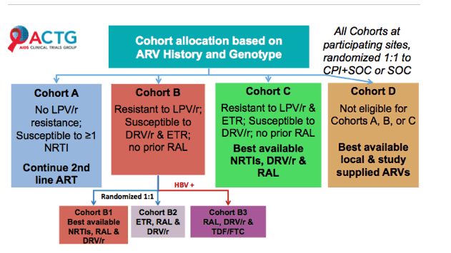
ACTG 5288 Strategy Study in RLS for 3L ART
10 countries in Africa, Asia, South America, Caribbean
% Pts A: 53% B1: 14% B2: 13% B3: 1% C: 13% D:6%
Grinsztejn B et al CROI 2018, 30LB
Notes:
Participants: candidades for 3rd line ART with VL 1000 copies/mL & more 24 wks of PI-containing 2nd line ART
Open label phase IV strategy study
1º Outcome: Suppression of plasma HIV-RNA <200 c/mL at 48w CI 95%
Stanford HIVdb 6.2 algorithm with modifies rules for DRV and ETV
DRV >3 DRV-associated mutations
ETR > 2.5 with mutations weighted

Slide 8
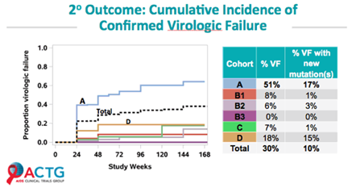
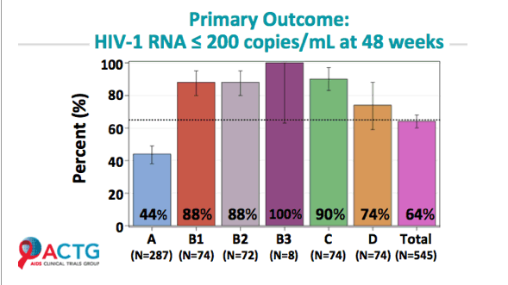
ACTG 5288
Grinsztejn B et al CROI 2018, 30LB
Notes:
Even group A was the one with less base line resistance, it teaches us that mantaing a failing régimen in the absence of resistance does not lead to a good outcome

Slide 9
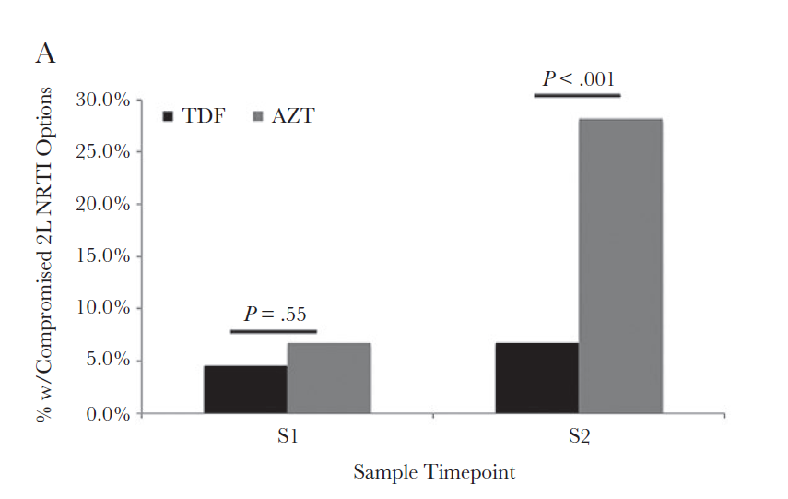
Implication of First-Line ARV Tx choice on Second-Line Options in RLS
Patterns of DRM from patients failing AZT-containing ART vs TDF
Predicted susceptibility to second-line tx NRTI backbone options
Nigeria n=191 pts
In stratified evaluation, pts with 0-6 months between tested VL samples had no difference in the proportion of compromised drugs to 2LR
Those >6 m between samples had significant difference in the proportion of compromised 2L NRTI
In multivariate analyses, pts on 1LR AZT had 9.9 times higher odds of having a compromised 2LR NRTI option than pts on 1LR TDF
Meloni M et al Open Forum Infectious Diseases 2017 DOI: 10.1093/ofid/ofx233
Notes:
AZT containing 1LR
28.2% pts AZT-1LR developed resistance to TDF vs 6.8% of pts on TDF- 1LR had resistance to AZT
There are limited data regarding 1L régimen choice and duratión of VF on the accumulation of mutations, particularly in resource-constrained settings that have acces to VL monitoring
Potencital lower efficacy of NRTIs due to accumulated mutations and the limited Access to drug resistance testing.
Before 2010 clinical advisory staff recommended using 3 NRTI in 2L régimen with the rationale that the régimen would provide expanded coverage, in 2013 pts that were receiving 3 NRTI were switched to 2, per Who recommendations
All pts received tx according to national and WHO guidelines at the time. Lack of Access to resistance data
Blood samples were drawn at baseline, 3 months and every 6 m thereafter unless clinical indiations, until 2010 program dropped VL at 3 months, In shifted to 6,12 and every 12 m thereafter 2014 .
Drug resistance mutations genotypes were generated on first available specimen after VF (S1), and closest to the time of 2L switch (S2 smaple)

Slide 10
Pretreatment Drug Resistance in LMICs
WHO reported prevalence estimates for HIV resistance
2010 NNRTI 5.5% in LMICs
20% of adults receiving ART for 6-12 m have unsuppressed VL
70-90% people with treatment failure on ART have drug-resistant virus
PreTx DR in LMICs is rising in contrast to HIC where the prevalence has declined
Review 2001-2016, 358 datasets, 56044 adults in 63 countries
The presence of NNRTI DR mutations prior to tx initiation of ART is associated with 2-3 times higher prevalence of Tx failure at 12 m
Gupta R et al. Lancet Infect Dis 2017;18:346-55
Avila-Rios S et al, PlosOne 2016;11(6):e
Avila-Rios S Lancet HIV, 2016;3(12):e579-591
Garcia-Morales et al J Antimicrob Chemother 2017;72(11):3149-58
Notes:
Substantial increases in pretreatment NNRTI resistance per year in all regions.
Mexico 2010 4.2 vs 2016 9.2 %

Slide 11
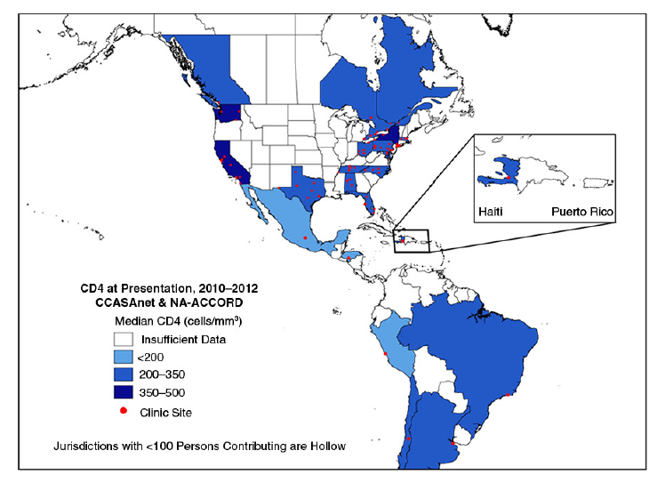
Other strategies, the experience from Latin America & Caribbean 2.1 million (5.7%) PLHA
WHO 90-90-90 objectives for 2020:
Latin America 81/ 72 / 79
Caribbean 64/ 81 / 67
CCASAnet cohort n= ~ 37,000
7 countries, 7 centers
Taller Latinoamericano N=99,639 pts 11 countries, 44 centers
VL monitoring 1.8 measurements per year
Costs vary greatly within the region:
CD4 7-64 USD, VL 20-186 USD
Resistance testing at first failure 84%
Resistance testing prior to ART 28%
1/3 pts exposed to ART stock out episodes
67% public founding
30% pts on 1LR on AZT
An estimated of 10 % on 1LFailure
UNADIS data 2017
Althoff K et cl, JIAS 2016;19:20707
Rev. Panam Infectol 2016;18(1):16.28
Belaunzaran-Zamudio PF . Bull World Health Organ 2015;93:529-39
Notes:
CCASAnet cohort Caribbean, Central, and South America Network
Taller Latinoamericano (TLA-HIV) -LA Workshop Study Group
High and rising HIV tx converge has come to reduce AIDS relatad moratlity by 12% from 43,000 in 2000, to 36,000 in 2016. mainly in Paru, Honduras and Colombia where AIDS-related deaths declinced by 62%, 58% ans 45%. AIDS related deaths rates were still rinsing in some contries notably Bolivia, Guatemala, Paraguay and Uruguay.
HIV resource avialability though has inproved over the last decate is still under the neds for about 30%

Slide 12
Mexico, the role of an Advisor Committee
Mexico included HIV treatment as a national health program in 2001
universal access to ART since 2014
Fragmented health care System
HIV treating physicians have a broad range of expertise
National guidelines for ARV treatment were available since 1997
National Guidelines were made mandatory by the Ministry of Health in 2004
Open access to ARV except for DRV, TPV, RAL, DTG, MVC, ETV, T20
National committees for the rational use of antiretrovirals were created in 2008 to provide advice to physicians caring for HIV pts
Initially aimed for the rational use of ARV in MDR treatment experienced patients, have now become a corner stone advisory committees for different aspects of HIV treatment (AE, simplification, earlier failures, HW-PEP )
Calva J et al Open Forum Infectious Diseases 2014;1(2):ofu081 DOI: 10.1093/ofid/ofu081
Bautista S AIDS 2006;20:101-109
Notes:
Fragmented health care System
HIV treating physicians have a broad range of expertise varying from general physicians to Internal medicine and infectious diseases specialists.
Because ARV prescription was highly variable and not assuring optimal treatment, National Guidelines were made mandatory by the Ministry of Health on Nov 2004
The peer advisory process is composed of 3 steps. In the first step, the physician completed a structured application form. This form collects data concerning patient plasma HIV-1 RNA (vRNA) plasma viral load measurements, CD4+ T-cell counts, coinfections, clinical events, concurrent medications (other than ARVs), a complete history of ARV therapy, and the reasons for drug changes (eg, virologic failure, adverse events, non-adherence, regimen simplification, or pharmacologic
interactions) since the HIV-infection diagnosis. The second step involved the individual assessment of patients by a panel of 10 senior clinicians with sound experience in ARV therapy. Based on the collected data (including resistance testing :HIV genotyping for 93% of all patients), each member of
the CORESAR (independent of the other members) proposed an optimized salvage regimen. These members sought to include at least 2 (preferably 3) fully active agents in the suggested
drug regimen whenever possible. The third step was providing the committee’s final recommendation and the rationale for this advice to the clinician caring for the patient. This recommendation
was decided by consensus among the board members via a case-by-case analysis and a discussion at a plenary meeting.

Slide 13
Mexico, the role of an Advisor Committee
HIV in Mexico: a concentrated epidemic estimated 230,000 PLHA 141,000 on ART
HIV crude seroprevalence 0.2 % 15-49 y PW 0.07% 17% MSM, 20% TW , PID 6%
Secretaria de Salud
n= 81,000 94 % on ART n= 2,870
83 % VS open ARV vs 80.6% among heavily ARV experienced pts CORESAR
Instituto Mexicano del Seguro Social
n = 46,269 pts, 92.4% on ART n=3800
83% VS open ARV vs 92% GERA
This experience in Mexico has allow us to better optimize resources and facilitate the best ART combination for each case, according to a group of Experts
Gutierrez JP et al Salud Publica Mex 2014;56:323-32 Colchero MA et al Salud Publica Mex 2015;57:99-106
Hernandez Avila J Acquir Imunol 2015;69(3):e100 Calva JJ et al Open Forum Infec Dis 2014 Sep 10;1(2):ofu 081
Calva JJ et al, AIDS Res Hum Retroviruses 2017;33(7):675-680
Notes:
GERA 15 casos semanas + comite cambio institutciones
Overall mortality 3,7 per 100,000 hab Median baseline CD4: 158 141,000 pts on ART
Effectiveness of the program 9.5 years follow up
Mencionar el efecto de los comites en Educación de medico con menos experiencia

Slide 14
Outline of ART in RLS
LMICs common settings:
ART stock outs
Limitations on Tx monitoring (VL, CD4, resistance tests)
Poor retention in care
Fragmented health systems
Funding constraints with increasing patient loads that pressurize healthcare systems
Notes:
INSPIRING trial DTG in TB doble dose safe and effective

Slide 15
Take-home Messages
Outcomes from the EARNEST, 2LADY and SELECT studies suggest resistance testing may not be required in patients failing a 1LR based on NNRTI
If available, information of resistance mutation will be important for future regimens
The combination of LPV/r + RAL is a safe option as efficacious as bPI + 2NRTI for 2LR
DTG + 2 NRTI appears to be superior bPI + 2 NRTI regimens (DAWNING), with a better safety profile, and lower costs than RAL
Even with documented resistance to NRTI, there is clear evidence of their roll in rescue treatments
VF in the absence of documented resistance suggests non-adherence and should be addressed based on the results of ACTG 5288
Advisory committees might have a roll for optimizing resources while assuring optimal ART in RLS
Notes:
MoA, mechanism of action; MDR, multidrug resistant. RLS resource limited settings
Despite non-inferiority of LPVr + RAL this regimen has side effects and is inconvenient
The combination of LPV/r + RAL is a safe option as efficacious as blip + 2NRTI for 2LR based on the SECOND-LINE, EARNEST, and SELECT studies
Considered in patients with NRTI intolerance
RAL more costly than LPV/r

Slide 16
Acknowledgments
Juan Calva Mercado
Brenda Crabtree
Alicia Piñeirua
Santiago Pérez Patrigeon
Marisol Valenzuela Lara
Luis Soto Ramírez
Juan Sierra Madero
Santiago Ávila Ríos
Trip Gulick
Ernesto Martínez Buitrago (Colombia)
Néstor Sosa (Panamá)
Omar Sued (Argentina)
Marcelo H Losso (Argentina)
Arnoldo Casiró (Argentina)

